Slide 1
Analysis of ANZ Customer Transaction Data
Yilan Chen

Slide 2
Data for Each Month
 | Total Amount | Number | Average
August | 729935.52 | 3943 | 185.1218666
September | 730550.21 | 4013 | 182.0459033
October | 802798.47 | 4087 | 196.4273232
Total | 2263284.2 | 12043 | 187.933588
The total amount of transaction and the total number of transfers in August and September is similar
The total amount of transaction and the total number of transaction increased slightly in October, and the average transfer amount increased by about 7% compared to the previous two months
Average transaction amount is $187.933588

Slide 3
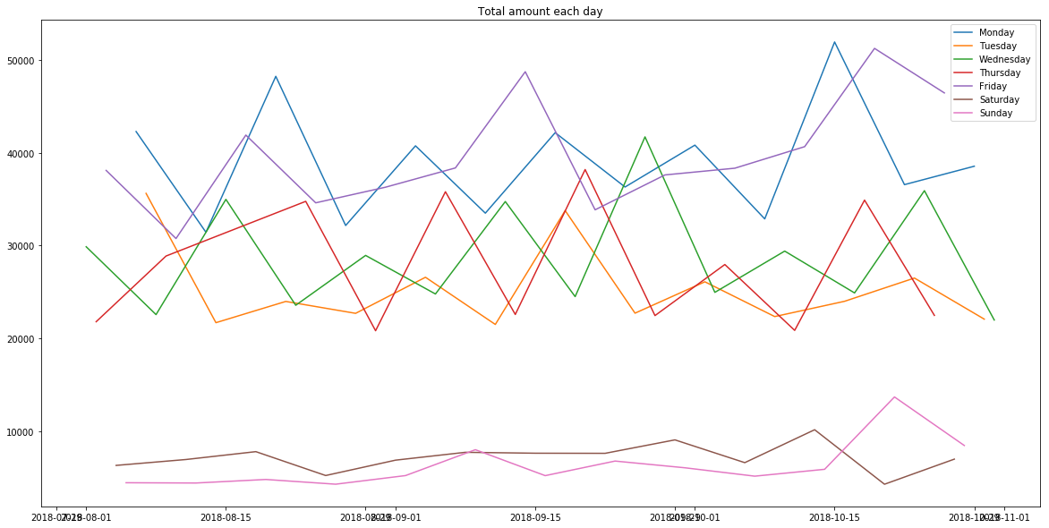

Slide 4
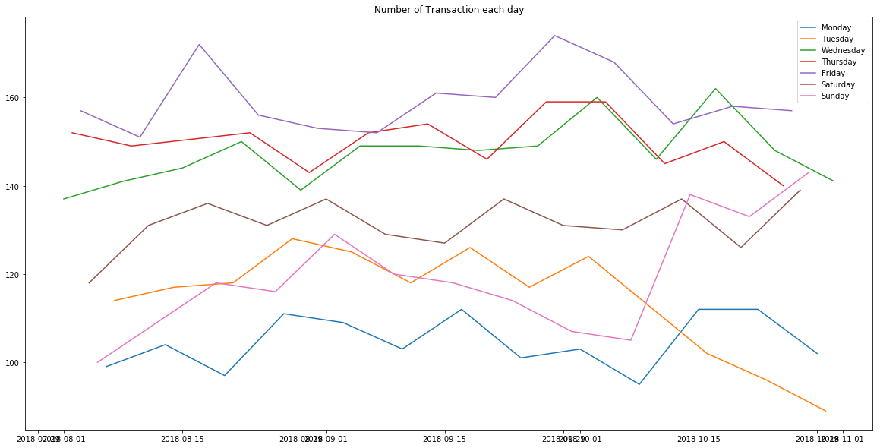

Slide 5
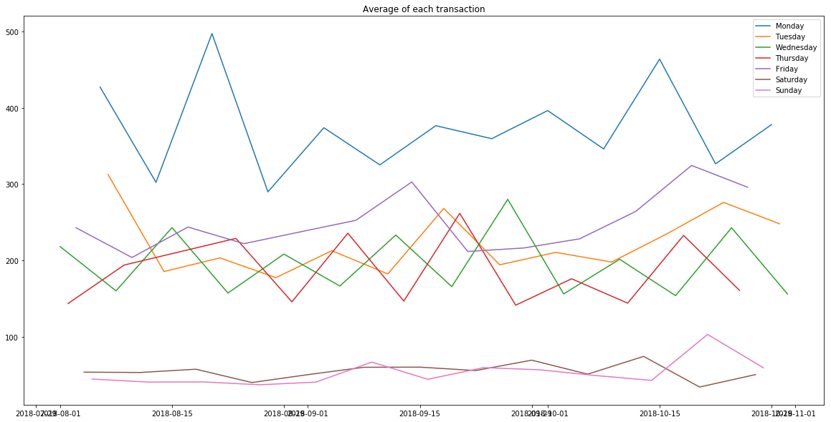

Slide 6
The total daily transaction amount and average transaction amount on weekdays are significantly higher than those on weekends
The total daily transaction amount on Monday and Friday is generally higher than the other three working days
The number of transaction on Friday is the highest overall but the total number of transfers per day on Monday is the lowest overall
Finding:
ANZ customers prefer to make transfers on working days, and like to make small number of transactions with large transaction amount on Monday and large number of transactions with small transaction amount on Fridays
ANZ customers are generally reducing transaction amount on weekends

Slide 7
Gender
 | Total Amount | Number | Average
Female | 970322.63 | 5758 | 168.5173029
Male | 1292961.57 | 6285 | 205.7218091
1. The total transaction amount of male is about 33% higher than that of Female.
2. The number of transaction is about 9% higher than that of Female.
3. The average transaction amount is about 22% higher than women
Males are significantly more active than females in transaction behavior

Slide 8
Age
Customers under the age of 20 have a small transaction amount and a small number of transactions.
Customers aged 20-30 have the most number of transaction , but the average transaction amount is at a low level.
ANZ customers over the age of 70 have the lowest number of transaction, but the average transaction amount is at a relatively high level.
Young customers are more inclined to make large number of transactions with small transaction amount , and older customers tend to make small number of transactions with large transaction amount . With age, the number of transaction gradually decreases, and the amount of each transaction gradually increases.
 | Total amount | Number | Average
<20 | 29267.64 | 190 | 154.0402105
(20,30) | 865359.65 | 5337 | 162.1434607
(30,40) | 627155.66 | 3200 | 195.9861438
(40,50) | 443423.79 | 1953 | 227.0475115
(50,60) | 62034.85 | 194 | 319.767268
(60,70) | 29267.64 | 190 | 154.0402105
>=70 | 10845.25 | 34 | 318.9779412

Slide 9
https://rpubs.com/thongtran94/anz1

